Slide 1
CSS(Cascading Style Sheets)
It is Case sensitive language
CSS are used to apply some attractive features (look and feel) of our web page .
Types of css:-
Inline CSS:- Can be placed inline within any tag with the help of style attribute. (Not recommended)
eg : <h1 style="color : red ; border:2px solid green ;"> Hello </h1>
Internal (embedded) CSS can be placed in <style></style> tags in head or body section
External CSS- this stylesheets are stored as .css files
It is mainaly used to apply the same formatting in all of our web pages .
The extension is .css
First we create a .css file and put the styles there and call that css file in any web page with the help of link tag.
Eg: <link rel="stylesheet" type="text/css" href="my.css" />

Slide 2
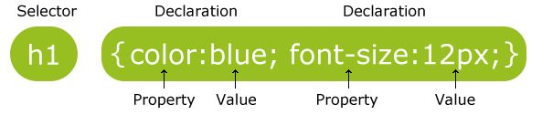
Syntax
h1 {
color: blue;
font-size:12px;
}
p {
text-align:center;
color:cyan;
}
div {
background-color: black;
border: red 1px solid
}

Slide 3



CSS Rules
Selector
body {
font-family: Tahoma, Arial, sans-serif;
color: black;
Background-color: red; margin: 8px;
Declaration Block
}
Property
Value

Slide 4
Adding Styles to HTML
External style sheet (best way)
<head>
<link rel="stylesheet" type="text/css" href="my.css" />
<style type="text/css">
body {
font-family: Tahoma, Arial, sans-serif;
}
</style>
</head>
<body>
Internal styles
<div style="padding:2px;color:red; ">
</body>
Inline styles(Not Recommended)

Slide 5
CSS Selectors
Selectors can be based on the element name, id, class, attribute and more
Element/tag selector = p {color : black;}
ID Selector = #box{background-color: black;}
or p#box { background-color:black;}
Class Selector = .center {text-align : center;}
or p.center {text-align : center;}
Grouping Selectors = h1, p, #idName,.className{color : red;}
Attribute Selector=Ex. a[ href ] {color : blue;}
* Selector= Ex. *{color : red;}

Slide 6
Id Selector
It is define with #(sign) with id name and call in any element with id attribute. If we want a unique style for an element then we use it .
eg:
<style>
#demo{ -----}
Or
div#demo{ -----}
</style>
In HTML File-
<div id=“demo">
---
</div>

Slide 7
Class selector
it is define with .(sign) with class name and call in any element with class attribute.
eg:
<style>
.demo{color:red; font-size:20px;}
Or
p.demo{color:red; font-size:20px;}
</style>
<p class=“demo"></p>

Slide 8
Selector | CSS | HTML
Tag name | h1 { color: red; } | <h1>Today’s Specials</h1>
Class attribute | .large { font-size: 16px; } | <p | class="large">...
Tag and Class | p.large {...} | <p | class="large">...
Element id | #para { font-weight: bold; } | <p | id="para">...
Tag and ID | p.#para {...} | <p | id="para">...

Slide 9
CSS Comments
h1 {
color: red;
/* This is a single-line comment */
text-align: center;
}
/* This is
a multi-line
comment */

Slide 10
CSS Colors
Colors can be specified multiple ways
The following all specify a red paragraph
A valid color name - p {color: red}
An RGB value – p {color: rgb(255, 0, 0)}
A HEX value – p {color: #ff0000}

Slide 11
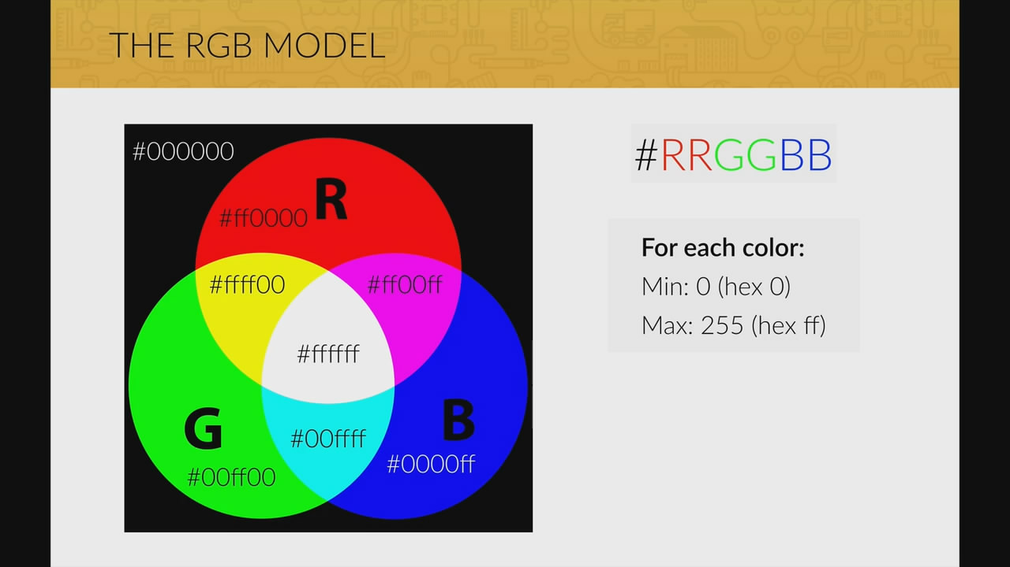
RGB Model

Slide 12
Common Properties
color
background-color
background-image
background-position
background
margin
padding
text-align
float
border-color
border-width
border-style
border
font-family
font-size
font-weight
font-style
overflow
display
max-width
height
width
line-height
text-decoration

Slide 13
CSS Backgrounds
The CSS background properties are used to define the background effects for elements.
background-color
background-image
background-repeat
background-attachment
background-position
background-size
background(shorthand property)

Slide 14
Border
border properties allow you to specify the style, width, and color of an element's border.
border-style
border-width
border-color
border-style values are allowed:
dotted - Defines a dotted border
dashed - Defines a dashed border
solid - Defines a solid border
double - Defines a double border
groove - Defines a 3D grooved border. The effect depends on the border-color value
ridge - Defines a 3D ridged border. The effect depends on the border-color value
inset - Defines a 3D inset border. The effect depends on the border-color value
outset - Defines a 3D outset border. The effect depends on the border-color value
none - Defines no border
hidden - Defines a hidden border(By default)

Slide 15
Margin
Used for outside space
It accept negative value.
CSS has properties for specifying the margin for each side of an element:
margin-top
margin-right
margin-bottom
margin-left
margin(shorthand)

Slide 16
Padding
Use for inside Space
Note- Negative value is not accepted in padding.
Padding - Individual Sides
padding-top
padding-right
padding-bottom
padding-left
padding

Slide 17
Outline
outline is a line that is drawn around elements, OUTSIDE the borders.
CSS has the following outline properties:
outline-style -> same value as border-style property
outline-color
outline-width
outline-offset
outline

Slide 18
Text Property:
color
text-decoration -underline, overline, line-through, none
text-align -center, left, right, justify(should be multiple line of text)
text-transform – lowercase,uppercase,capitalize
text-indent
letter-spacing
line-height
word-spacing
text-shadow

Slide 19
Font
font-family
font-style
font-variant
font-weight
font-size

Slide 20
Font-family
Google Font API
https://fonts.google.com/

Slide 21

font-style
normal - The text is shown normally(By default)
italic - The text is shown in italics
oblique - The text is "leaning" (oblique is very similar to italic, but less supported)
font-weight
font-weight: normal; font-weight: bold/bolder/100-900;//400 -normal
Font Variant
font-variant: normal; (By default)
font-variant: small-caps;

Slide 22
font-size
font-size:20px;
Note:
1em=16px
font-size: 2.5em; /* 40px/16=2.5em */

Slide 23
Font Awesome Icons
To use the Font Awesome icons, go to fontawesome.com, sign in, and get a code to add in the <head> section of your HTML page:
<link rel="stylesheet" href="https://use.fontawesome.com/releases/v5.14.0/css/all.css" integrity=“Your code" crossorigin="anonymous">
Ex-
<i class="fas fa-heart"></i> <i class="fas fa-car"></i> <i class="fas fa-file"></i> <i class="fas fa-bars"></i>

Slide 24
table
border-collapse-collapse;
width
height
vertical-align: top,bottom,center(By default)

Slide 25
Combinators
relationship between the selectors.
There are four different combinators in CSS:
descendant selector (space)
child selector (>)
adjacent sibling selector (+)
general sibling selector (~)

Slide 26
Pseudo-class
A pseudo-class is used to define a special state of an element.
For example
Style an element/tag when a user mouses over it
Style visited and unvisited links differently
Style an element when it gets focus
Syntax
selector : pseudo-class
{ property: value; }

Slide 27
Anchor Pseudo Class
hover - Apply rule when mouse is over element
a:hover {
color: yellow;
}
a:link, a:visited - Apply rule when link has been visited or not visited (link)
a:link{
color:red;
}
a:visited { color: green;
}
a:active { color: blue;
}
Note:- active work after hover

Slide 28
:first-child, :last-child, nth-child() & :focus
:first-child
matches a specified element that is the first child of any element.
:last-child
matches a specified element that is the last child of any element.
:nth-child()
matches a particular element that is child of any element.
:focus()
work on focus and generally used with form element.

Slide 29
Pseudo-Elements
What are Pseudo-Elements?
A CSS pseudo-element is used to style specified parts of an element.
For example:
Style the first letter, or line, of an element
Insert content before, or after, the content of an element
Syntax
_{selector::pseudo-element {} _{property: value;} }

Slide 30
::first-line
The ::first-line pseudo-element is used to add a special style to the first line of a text.
The following properties apply to the ::first-line pseudo-element:
font properties
color properties
background properties
word-spacing
letter-spacing
text-decoration
vertical-align
text-transform
line-height
Clear
Note: The ::first-letter pseudo-element can only be applied to block-level elements

Slide 31
::first-letter
Note: The ::first-letter pseudo-element can only be applied to block-level elements.
The following properties apply to the ::first-letter pseudo- element:
font properties
color properties
background properties
margin properties
padding properties
border properties
text-decoration
vertical-align (only if "float" is "none")
text-transform
line-height
float
clear

Slide 32
::before, ::after, ::selection & ::marker
::before pseudo-element can be used to insert some content before the content of an element.
::after pseudo-element can be used to insert some content after the content of an element.
::selection pseudo-element matches the portion of an element that is selected by a user.
::marker pseudo-element selects the markers of list items.

Slide 33
Display and visibility properties
display: none;- Element is not displayed and takes no space in layout.
display: inline; - Element is treated as an inline level element. you can not set width and height and margin-top and bottom not set
display: inline-block;- allows to set a width and height on the element.
display: block; - Element is treated as a block element.
display: flex;- Element is treated as a flex container.(css Advance Topic)
visibility: hidden; - Element is hidden but space still allocated.
visibility: visible; - Element is normally displayed(By default)

Slide 34
position property
position: | static; | (default) - Position in document flow
position: | relative; | Position relative to default position via top, right, bottom, and left properties
position: | fixed; | Position to a fixed location on the screen via top, right, bottom, and left properties
position: | absolute; | Position relative to ancestor absolute element via top, right, bottom, and left properties
Position: | sticky; | Position sticky to ancestor absolute element via top, right, bottom, and left properties

Slide 35
Overlapping Elements
When elements are positioned, they can overlap other elements.
The z-index property specifies the stack order of an element (which element should be placed in front of, or behind, the others).
An element can have a positive or negative stack order.
eg:
img { position: absolute; left: 0px; top: 0px; z-index: -1; }

Slide 36
overflow
Overflow property controls what happens to content that is too big to fit into an area.
The overflow property has the following values:
visible - By Default.
hidden - The overflow is clipped, and the rest of the content will be invisible
scroll - The overflow is clipped, and a scrollbar is added to see the rest of the content
auto - Similar to scroll, but it adds scrollbars only when necessary

Slide 37
Float
float property specifies how an element should float.
float property is used for positioning and formatting content
e.g. let an image float left to the text in a container.
The float property can have one of the following values:
left - The element floats to the left of its container
right - The element floats to the right of its container
none - The element does not float .(By default)

Slide 38
Clear
It specifies what elements can float beside the cleared element and on which side.
The clear property can have one of the following values:
none - Allows floating elements on both sides. (By default)
left - No floating elements allowed on the left side
right- No floating elements allowed on the right side
both - No floating elements allowed on either the left or the right side

Slide 39
Opacity
opacity property specifies the opacity/transparency of an element.
The opacity property can take a value from 0.0 - 1.0.

Slide 40
CSS 3.0(Advance)
border-radius
Gradients
Linear
Radial
Web Font
Transformation
Transition
Animation
background-size
box-shadow
box-sizing
resize
Flexbox
Media Query

Slide 41
border-radius (Rounded Corners)
border-radius property, you can give any element "rounded corners".
border-radius: 15px 50px 30px 5px; (first value applies to top-left corner, second value applies to top-right corner, third value applies to bottom-right corner, and fourth value applies to bottom-left corner
border-radius: 15px 50px 30px; (first value applies to top-left corner, second value applies to top-right and bottom-left corners, and third value applies to bottom-right corner)
border-radius: 15px 50px; (first value applies to top-left and bottom-right corners, and the second value applies to top-right and bottom-left corners)
border-radius: 15px; (the value applies to all four corners, which are rounded equally

Slide 42
Gradients
Two types of gradients in CSS:
Linear Gradients (goes bottom(By default)/top/left/right/diagonally)
Syntax-
background-image: linear-gradient(direction(optional), color1, color2, ...);
Radial Gradients (defined by their center)
Syntax-
background-image: radial-gradient(shape(optional), color1,color2,…);

Slide 43
Web Font
Different Types of Font Format
TrueType Fonts (TTF)
OpenType Fonts (OTF)
The Web Open Font Format (WOFF)
SVG Fonts/Shapes
Embedded OpenType Fonts (EOT)

Slide 44
Ex-
@font-face { font-family: customFont; src: url(sansation_light.woff); } div { font-family: customFont; }

Slide 45
transform
Used to allow you to move, rotate, scale, and skew elements.
translate(x,y)
translateX()
translateY()
rotate()
scale()
scaleX()
scaleY()
skew(x,y)
skewX()
skewY()

Slide 46
transition
Used to change property values smoothly, over a given duration we use transition
Syntax:
transition: property duration timing-function delay;
transition-property(By default)
transition-duration
transition-delay
transition-timing-function
ease - specifies a transition effect with a slow start, then fast, then end slowly (this is default)
linear - specifies a transition effect with the same speed from start to end
ease-in - specifies a transition effect with a slow start
ease-out - specifies a transition effect with a slow end
ease-in-out - specifies a transition effect with a slow start and end

Slide 47
animation
@keyframes
animation-name
animation-duration
animation-delay
animation-iteration-count
animation-timing-function
ease - Specifies an animation with a slow start, then fast, then end slowly (this is default)
linear - Specifies an animation with the same speed from start to end
ease-in - Specifies an animation with a slow start
ease-out - Specifies an animation with a slow end
ease-in-out - Specifies an animation with a slow start and end

Slide 48
Ex-
/* The element to apply the animation to */ div { width: 100px; height: 100px; background-color: red; animation-name: example; animation-duration: 4s; }
/* The animation code */ @keyframes example { from {background-color: red;} to {background-color: yellow;} }

Slide 49
Flexbox: Flex Container
Flexbox Layout module
Ex-
Block, for sections in a webpage
The flex container properties are:
flex-direction-row(By default)/row-reverse/column/column-reverse;
flex-wrap-wrap/wrap-reverse;
flex-flow- shorthand of flex-direction and flex wrap
justify-content- center/flex-start(default)/flex-end/space-around/space-between;
align-items-center/flex-start/flex-end/stretch(default)/baseline
Note:-if u use any property of flexbox then u must include property (display:flex;)

Slide 50
Ex
<style>
.flex-container {
display: flex;
background-color: yellow;
}
.flex-container > div {
background-color: lightblue;
margin: 10px;
padding: 20px;
font-size: 30px;
}
</style>
<div class="flex-container">
<div>1</div>
<div>2</div>
<div>3</div>
</div>

Slide 51
Media queries
Media queries can be used to check many things, such as:
width and height of the viewport
width and height of the device
orientation (is the tablet/phone in landscape or portrait mode?)
resolution
Syntax-
@media screen and (max-width: 768px)
{
///////
}

Slide 52
Making Website
Start to make website

